Slide 1

Department of Computer Science & Technology
Project Name: Library Management System

Slide 2
List of Activities
Members can inquire at admin desk.
Admins will look up about inquiry and provide feedback.
Admins will issue books to registered members.
Admins can alter database information when needed.

Slide 3
Main Process and Sub Processes
Context Level | Level 0 | Level 1
0.0 Library Management System | 1.0 Inquiry | 1.1 Borrow Book
 |  | 1.2 Return Book
 | 2.0 Feedback | 2.1 Verify from Database
 | 3.0 Issue Book | 3.1 Lend Book
 |  | 3.2 Receive Book

Slide 4
Entities and Databases
Entities:
Admin
Member
Databases:
Admin Authorization Database
Member Information Database
Book Information Database
Records Management Database

Slide 5
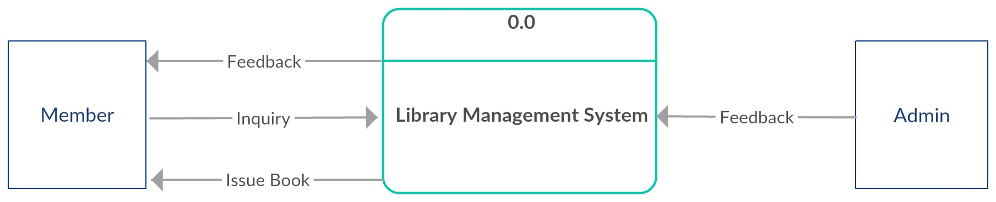
Context Level Diagram

Slide 6
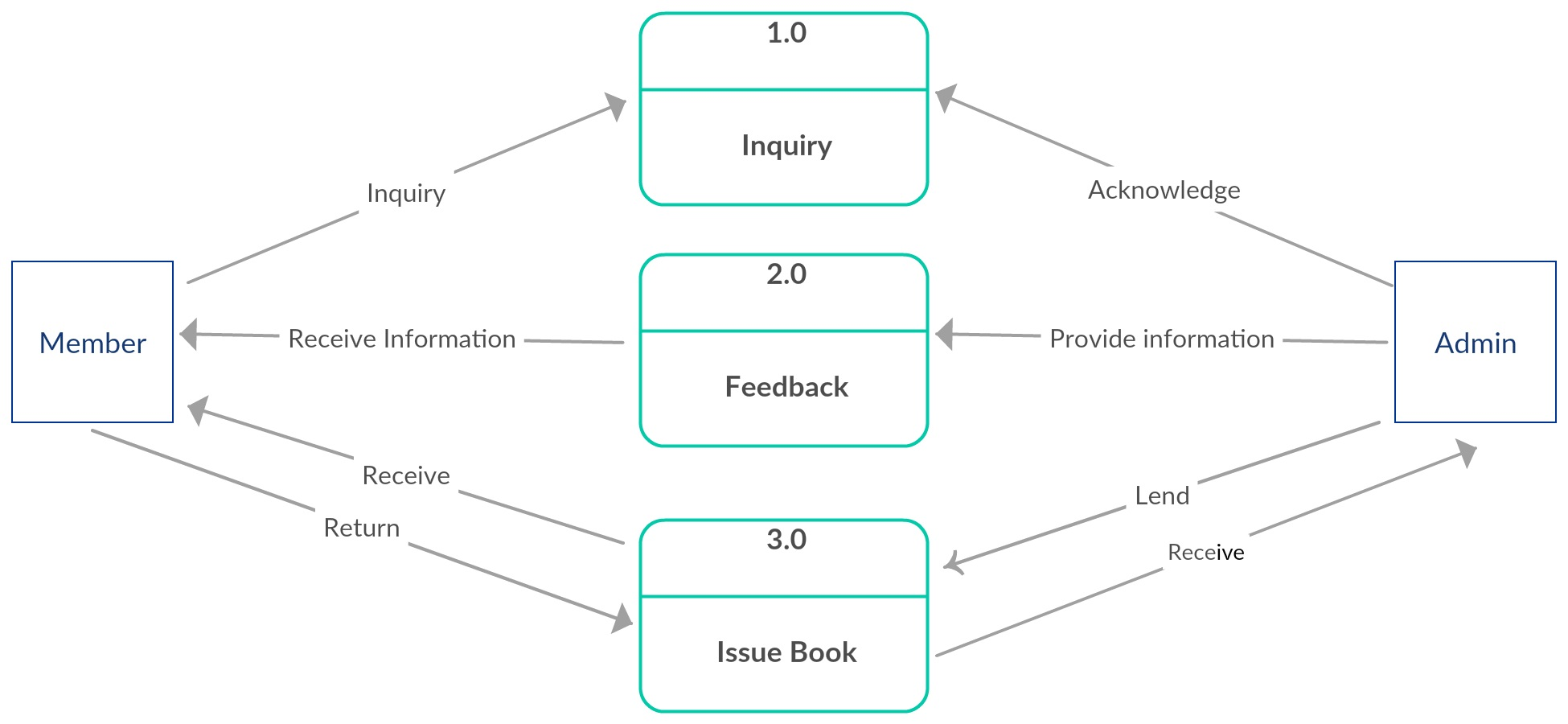
Level 0 Diagram

Slide 7
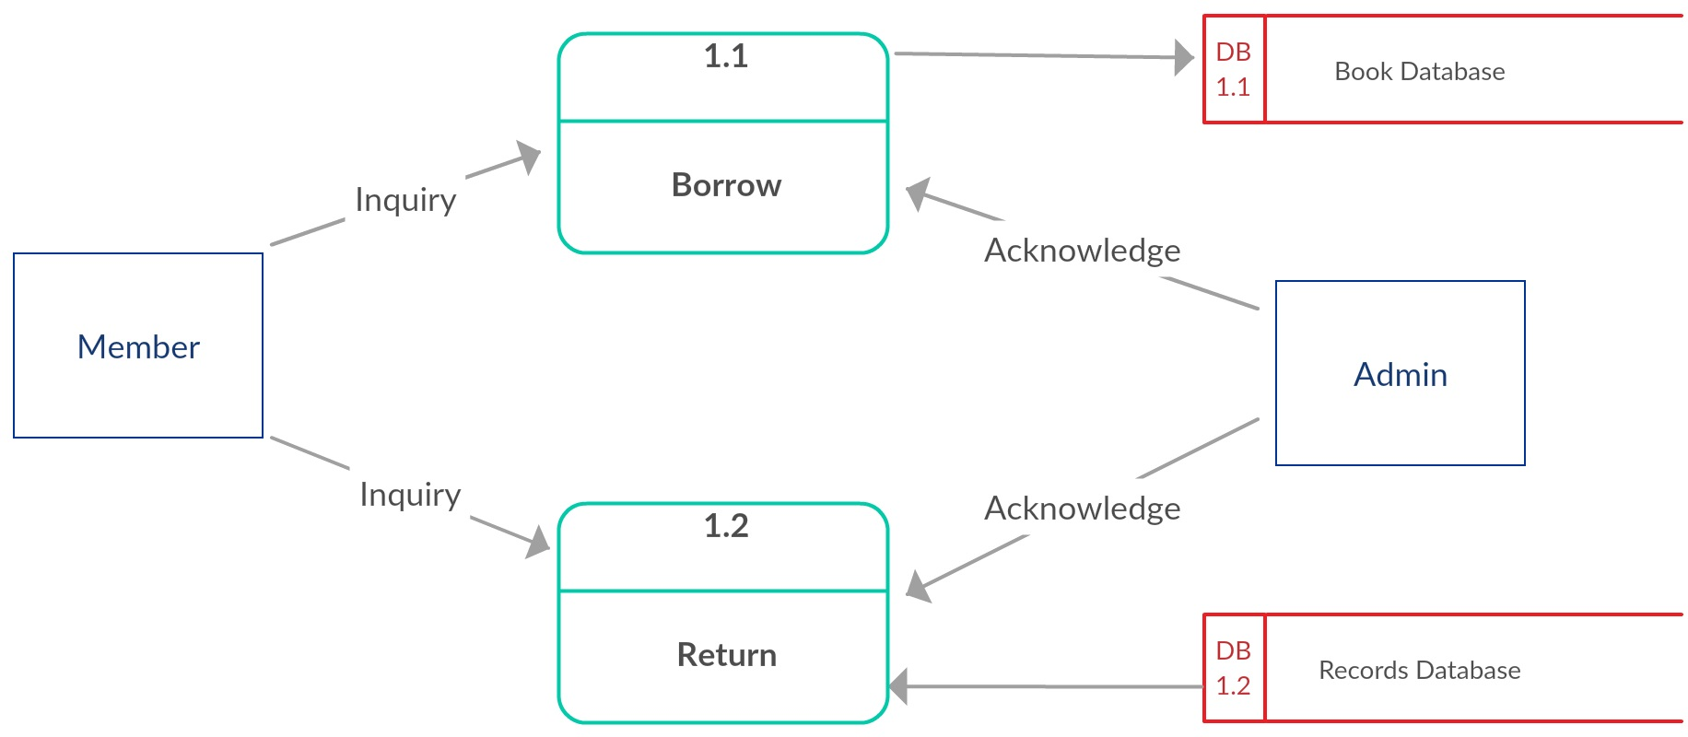
Level 1 Diagram (Inquiry)

Slide 8
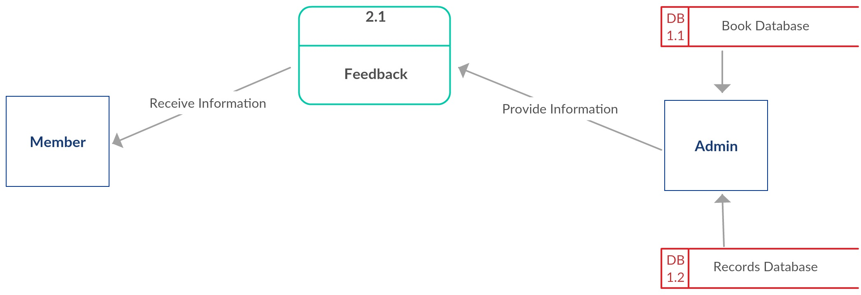
Level 1 Diagram (Feedback)

Slide 9
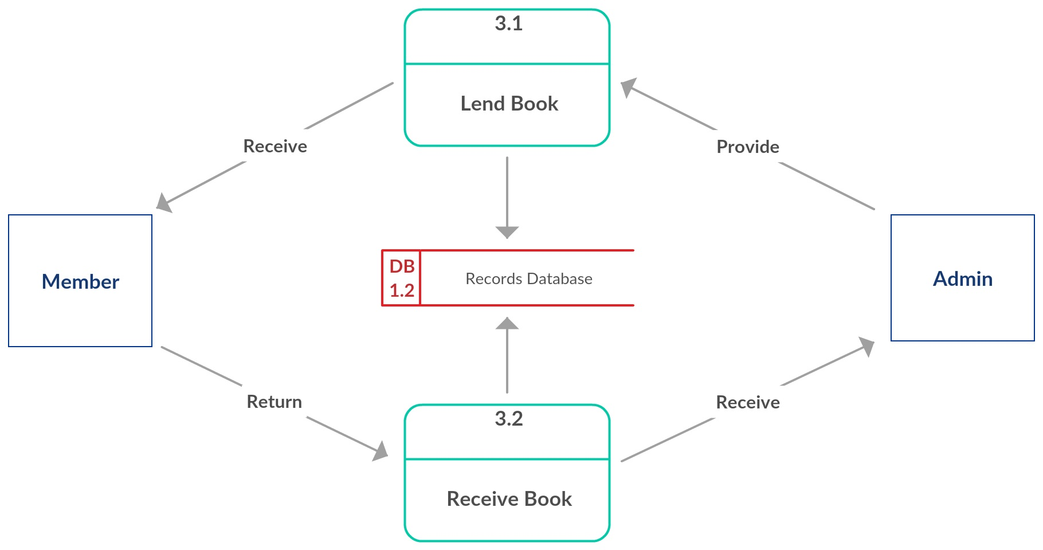
Level 1 Diagram (Issue Book)

Slide 10
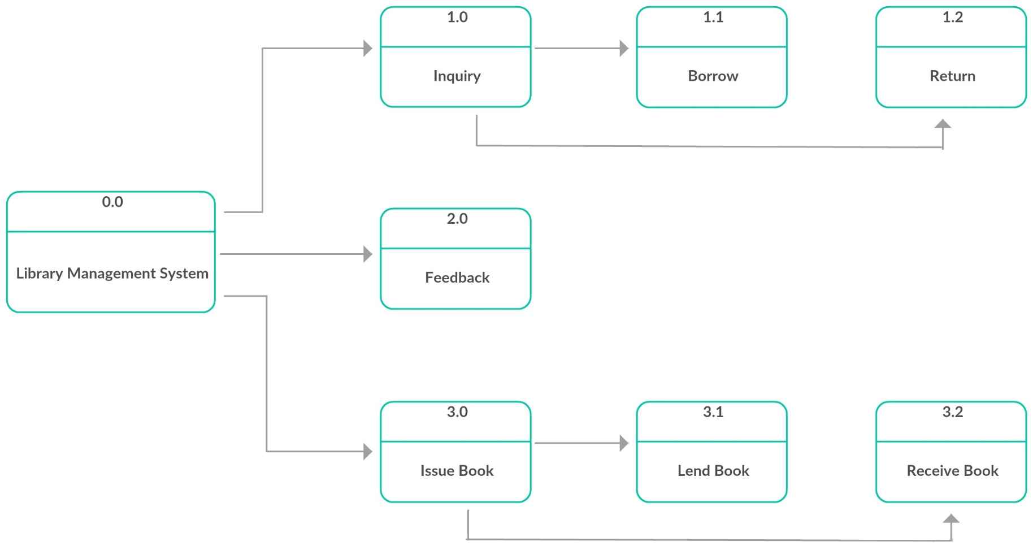
Process Decomposition

Slide 11
Thank You!
Any questions?
Feel free to ask!

